Slide 1
SMART AGRICULTURE
-BY
NITHAN .R (7376212AD169)
DHARANEESH . S(7376212AD122)
GOKUL KRISHNA .K (7376212AD129)
MOHANASHARAN .K (7376212AD163)

Slide 2
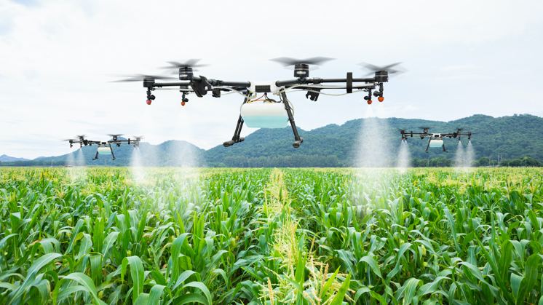
Overview about this ppt:
Abstract
Smart Agricultural System
Advantages
Disadvantages
Problem Statements
Block diagram – IOT and Vertical agriculture

Slide 3
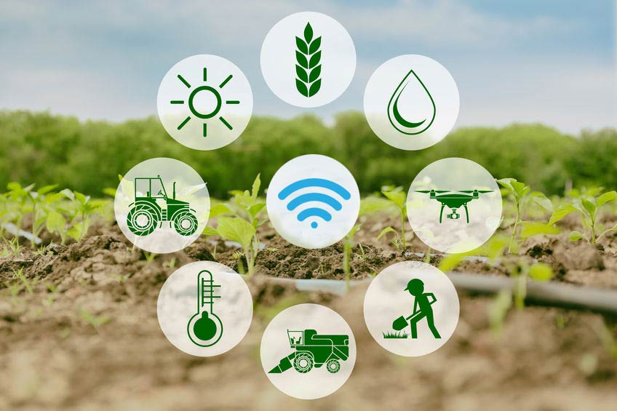
Abstract:
Smart agriculture is a farming system which uses IoT technology. This emerging system increases the quantity and quality of agricultural products. IoT devices provide information about nature of farming fields and then take action depending on the farmer input.

Slide 4
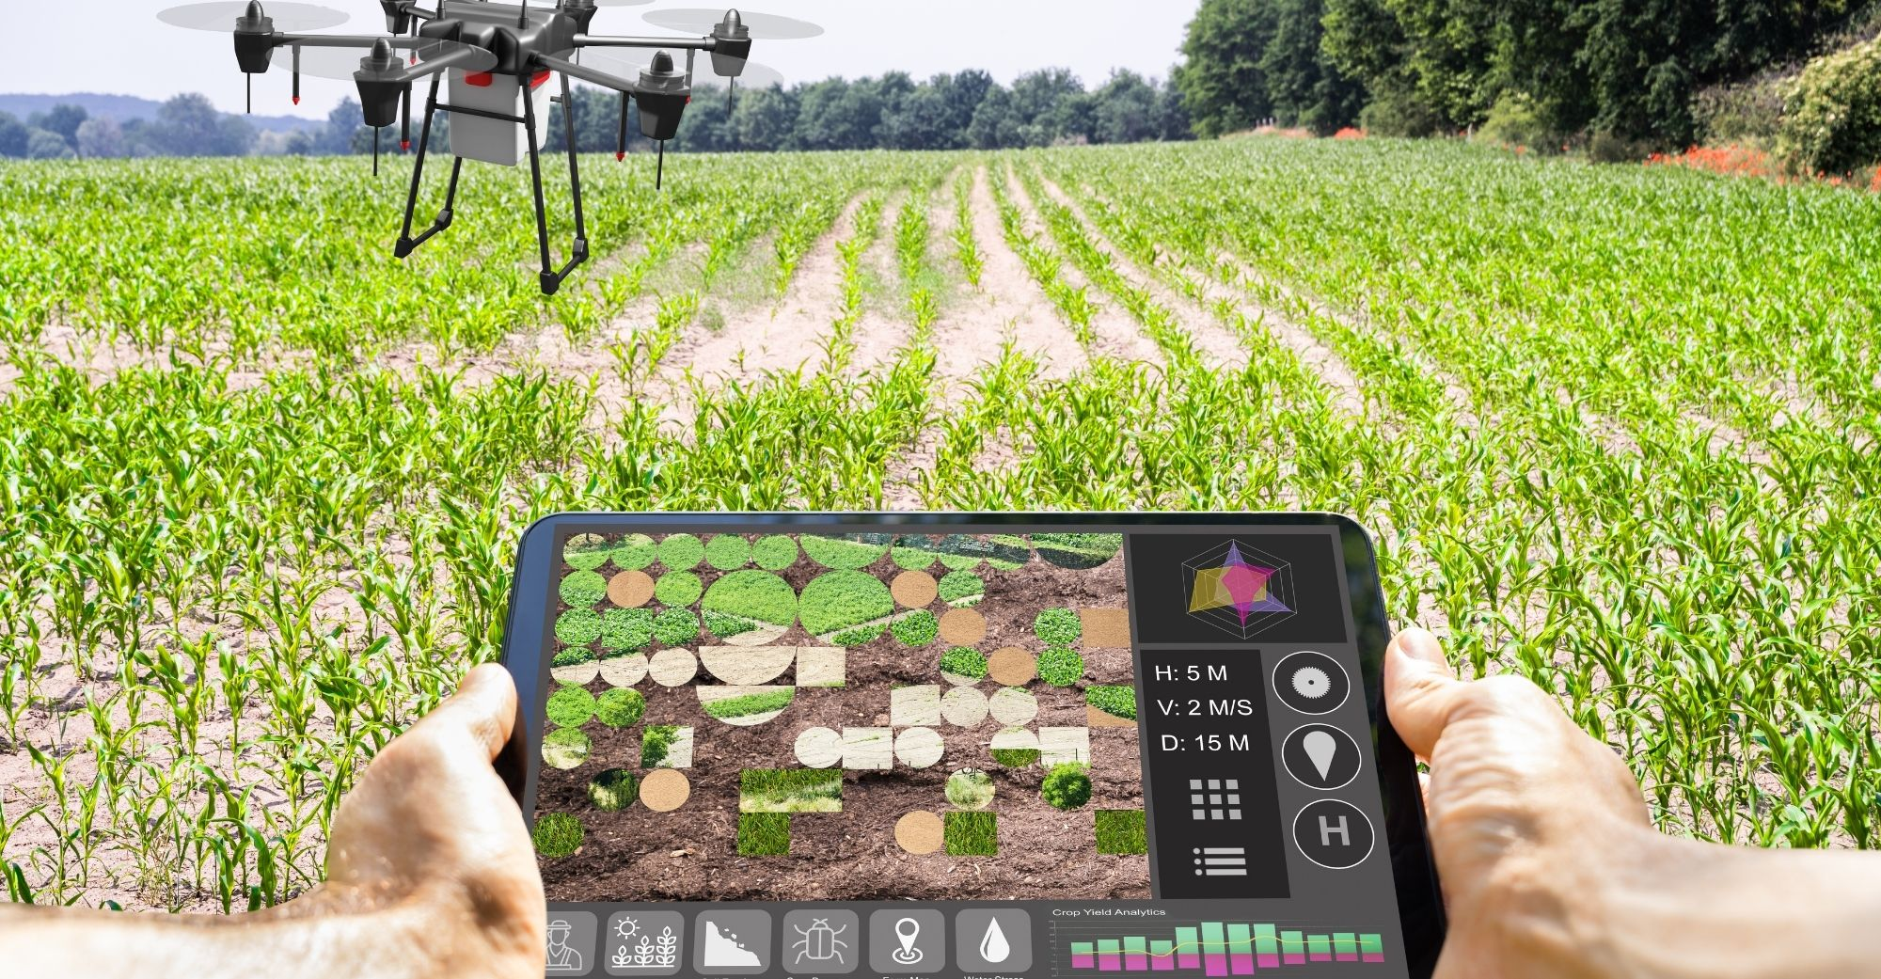
Smart agriculture system
Smart farming is a management concept focused on providing the agricultural industry with the infrastructure to leverage advanced technology – including big data, the cloud and the internet of things (IoT) – for tracking, monitoring, automating and analyzing operations.

Slide 5
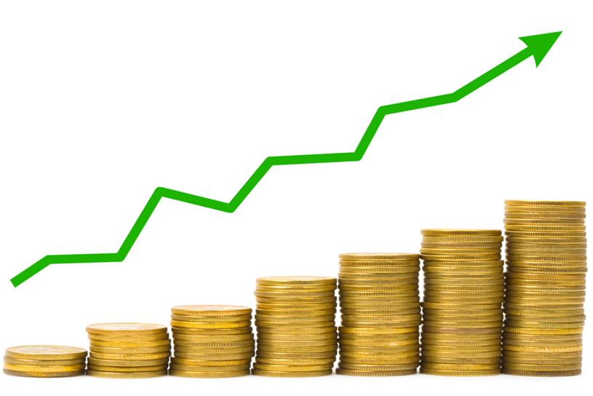
Is Smart agriculture Profitable?
Indeed technology brings positive impacts to farm management. As the products increase, more profit could be generated. Smart farming also helps farmers to distribute their commodities to the most rewarding markets or buyers. Some software connects the farmers to connect with the nearest potential buyers. Despite the gained earnings, farmers should be aware also of the maintenance and installation costs. Hence, profit is relative and may differ for each farmer.

Slide 6
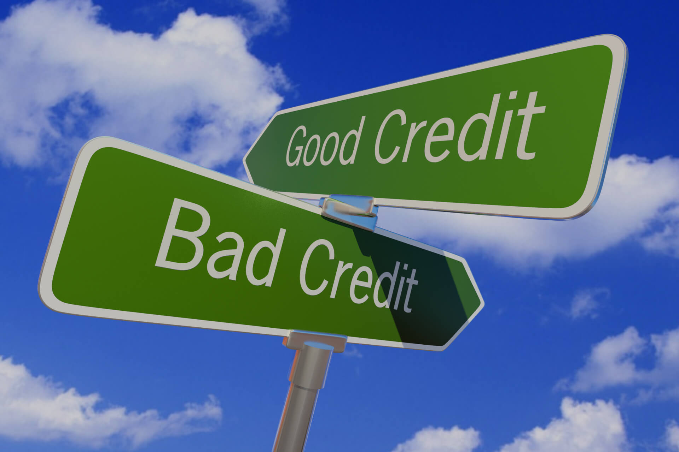
ADVANTAGES AND DISADVANTAGES IN SMART AGRICULTURE
This Photo by Unknown Author is licensed under CC BY-ND

Slide 7
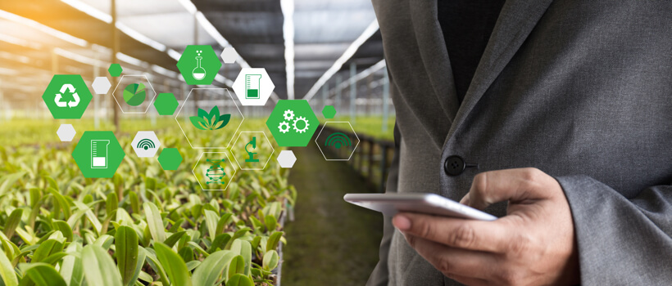
Benefits of Smart agriculture :
Improved products
Environmental friendly
Efficient management and cost-effective

Slide 8
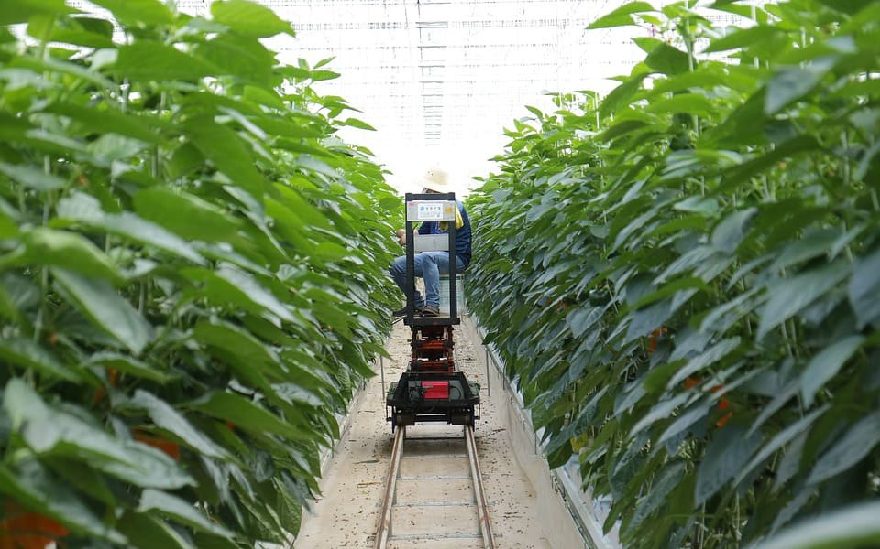
Improved products
With high-quality control and experiments, nowadays many farming ‘companies’ produce vegetables with a certain taste that is different from other vegetables. The greens mostly are categorized as organic.

Slide 9
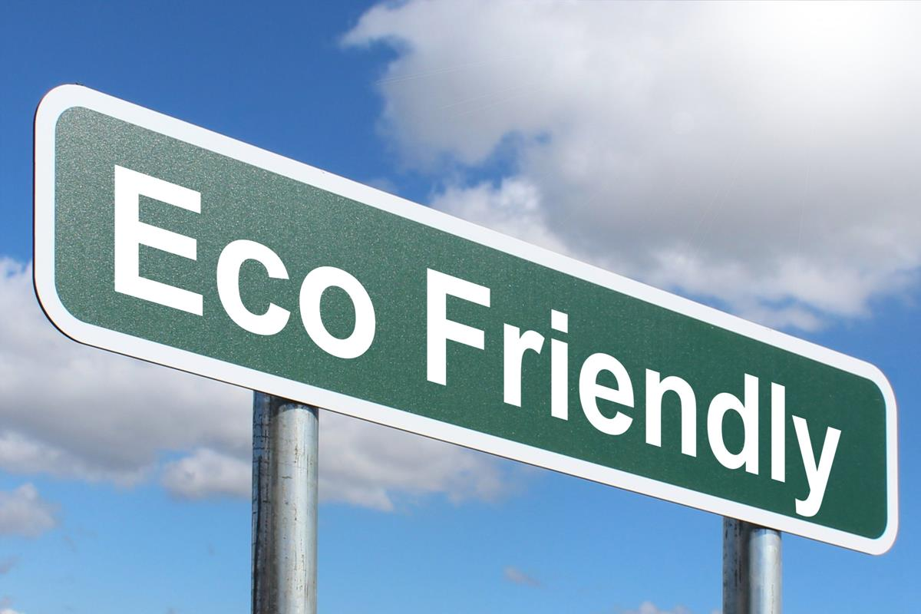
Environmental friendly
As farmers could minimize pesticide use, irrigate water sufficiently, manage waste efficiency, current farming damages are slowly getting revived. It is predicted that years from now, farmers could build a farm with varied commodities without removing the endemic flora and fauna.
This Photo by Unknown Author is licensed under CC BY-SA

Slide 10
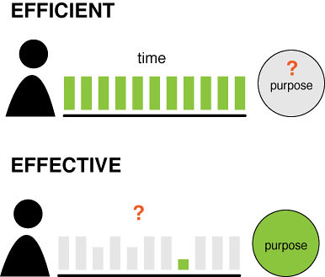
Efficient management and cost-effective
As many labor works are done by the technology, the management costs can be reduced or allocated to maintain the technology. The farmers could also be away, but keep controlling the farm from far away.
This Photo by Unknown Author is licensed under CC BY-NC-ND

Slide 11

Disadvantages of Smart agriculture
Despite the benefits above, smart farming also carries several potential risks. The biggest of them is prone to be damaged. Without any regular care, technology is prone to get broken by natural factors like heavy rain, strong wind, thunder strikes, and more. It could be a big loss for the farmer. Moreover, the maintenance cost is not cheap with updates and further research.
This Photo by Unknown Author is licensed under CC BY-NC

Slide 12
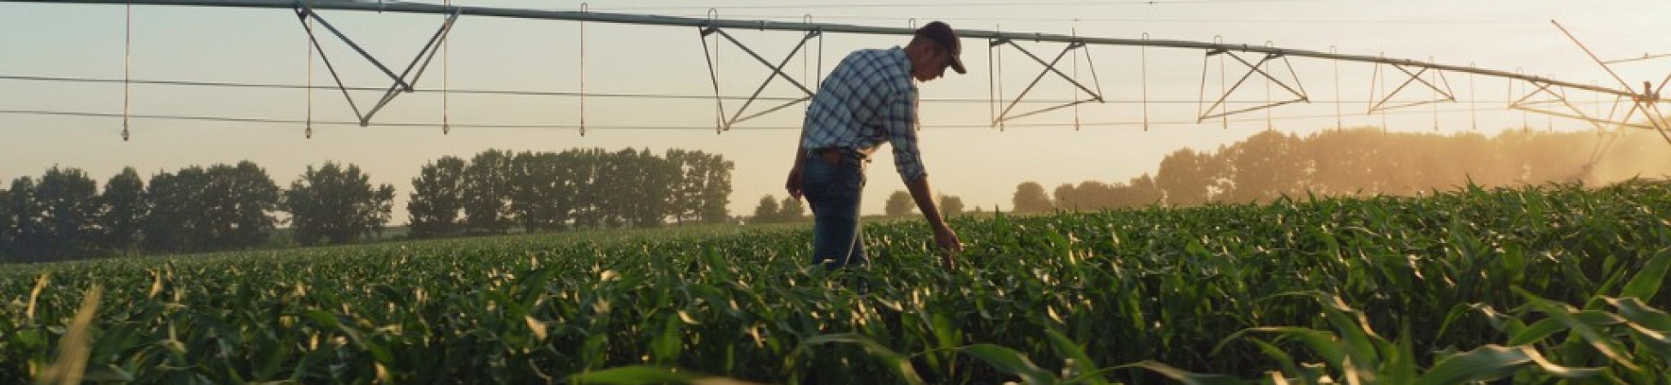
Farmers Use IoT
Smart farming with IoT is a growing business nowadays. The number of farmers using IoT is increasing and it is projected by the agriculture market in the U.S. that annual growth rate of 19.3%. a survey shows that technology installation in farming also has a similar growth rate that is 20%. This happens globally as many countries come up with modern innovations like Japan, India, Canada, Columbia, Mexico, Brazil, Chile, and Argentina.
This Photo by Unknown Author is licensed under CC BY-ND

Slide 13

PROBLEM STATEMENT
This Photo by Unknown Author is licensed under CC BY-SA-NC

Slide 14
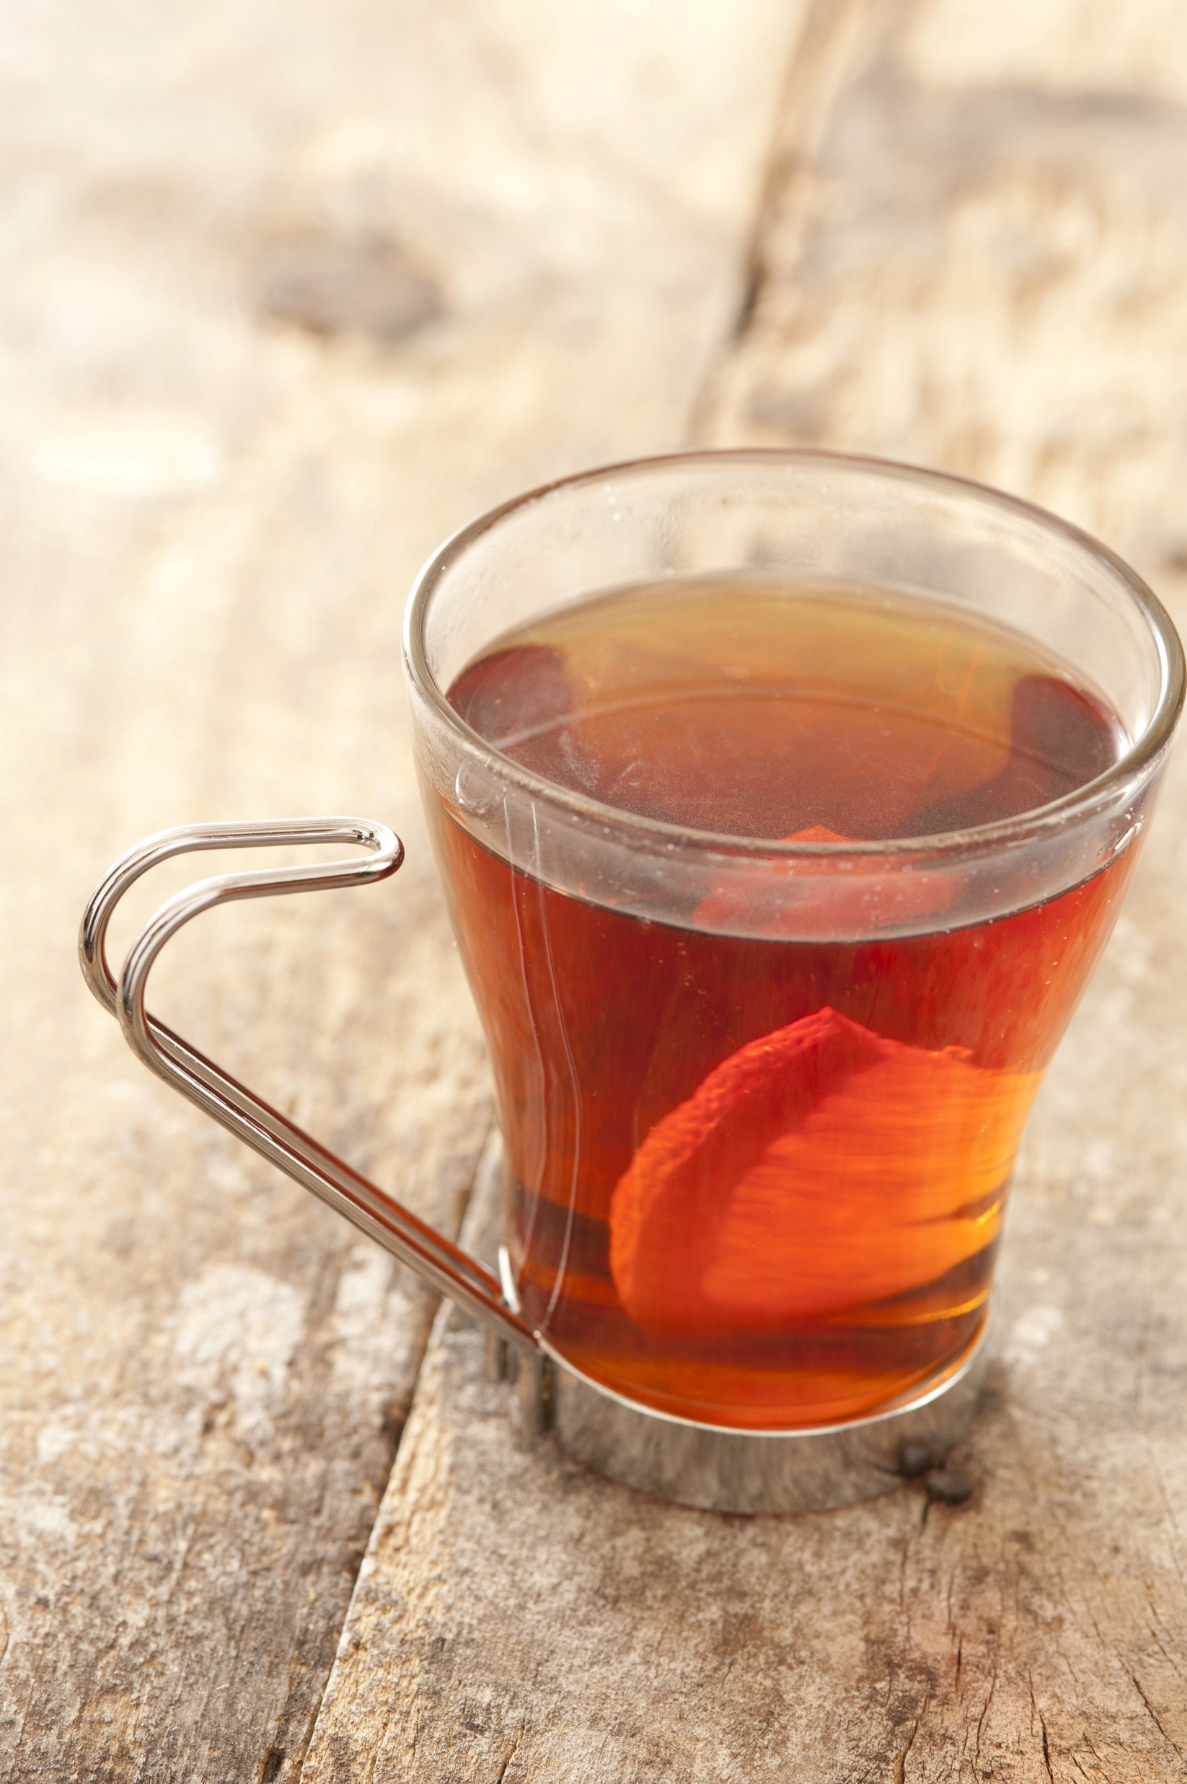
1. Tea Industry
Use of pesticides / fertilisers more than required quantity leads to rejection of the produced Tea.
b) Plucking coarse leaves will lead to drop in the quality of made Tea.
c) Tea pruning is widely used to keep the plants in ideal shape. However, too much pruning leads to destruction of the plant.
d) Processing of Tea from the leaves (withering, curled, fermentation, dried, sieves and packed) is a hectic and robust job.
e) Maintaining ideal storage condition. f) Exported / supplied stocks are rejected by the customers due to undesired quality.
This Photo by Unknown Author is licensed under CC BY

Slide 15
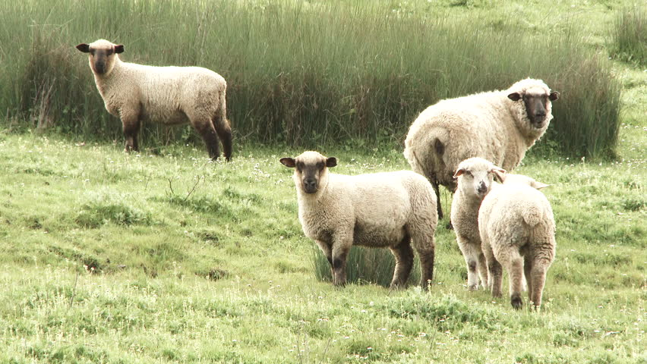
2. Livestock
Large farm owners can benefit from IoT applications to collect data regarding the location, well-being, and health of their cattle. This information helps them in identifying animals that are sick so they can be separated from the herd, thereby preventing the spread of disease. It also lowers labor costs as ranchers can locate their cattle with the help of IoT based sensors.

Slide 16
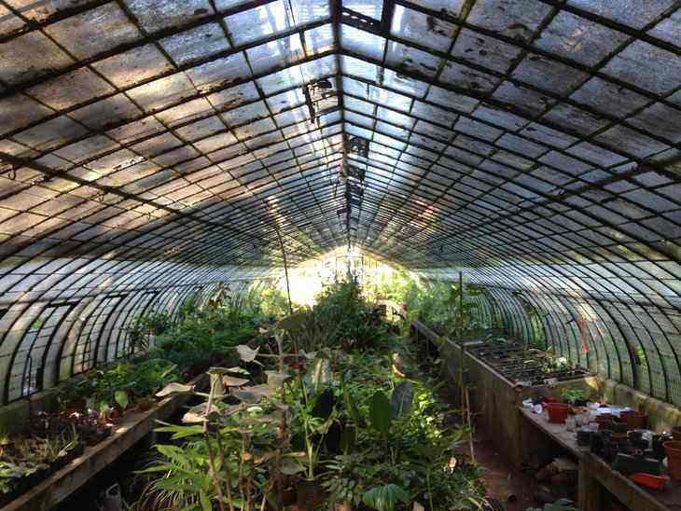
3. Smart Greenhouses
Greenhouse farming is a methodology that helps in enhancing the yield of vegetables, fruits, crops etc. Greenhouses control the environmental parameters through manual intervention or a proportional control mechanism. IoT applications can immensely benefit the farmers using greenhouse technology and make their work simple & easy.
This Photo by Unknown Author is licensed under CC BY-SA

Slide 17
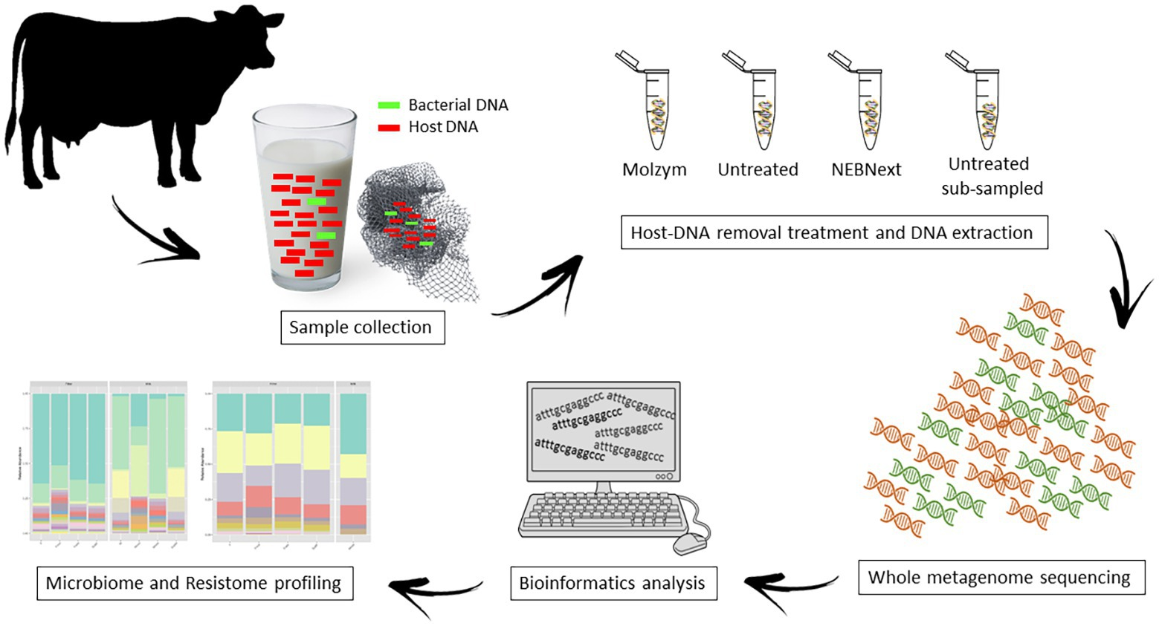
4. Detection and analysing parameters of milk at different stage of collection
If we can get the important milk parameters during different stages of collection i.e. from cattle farm to dairy collection centre including health of the animals. This will be helpful in pasteurization process and knowing the important parameters from cattle farm itself will be really helpful in milk processing too. IoT applications can provide solutions in maintaining the quality of food products and over all safety of the consumers.
This Photo by Unknown Author is licensed under CC BY

Slide 18
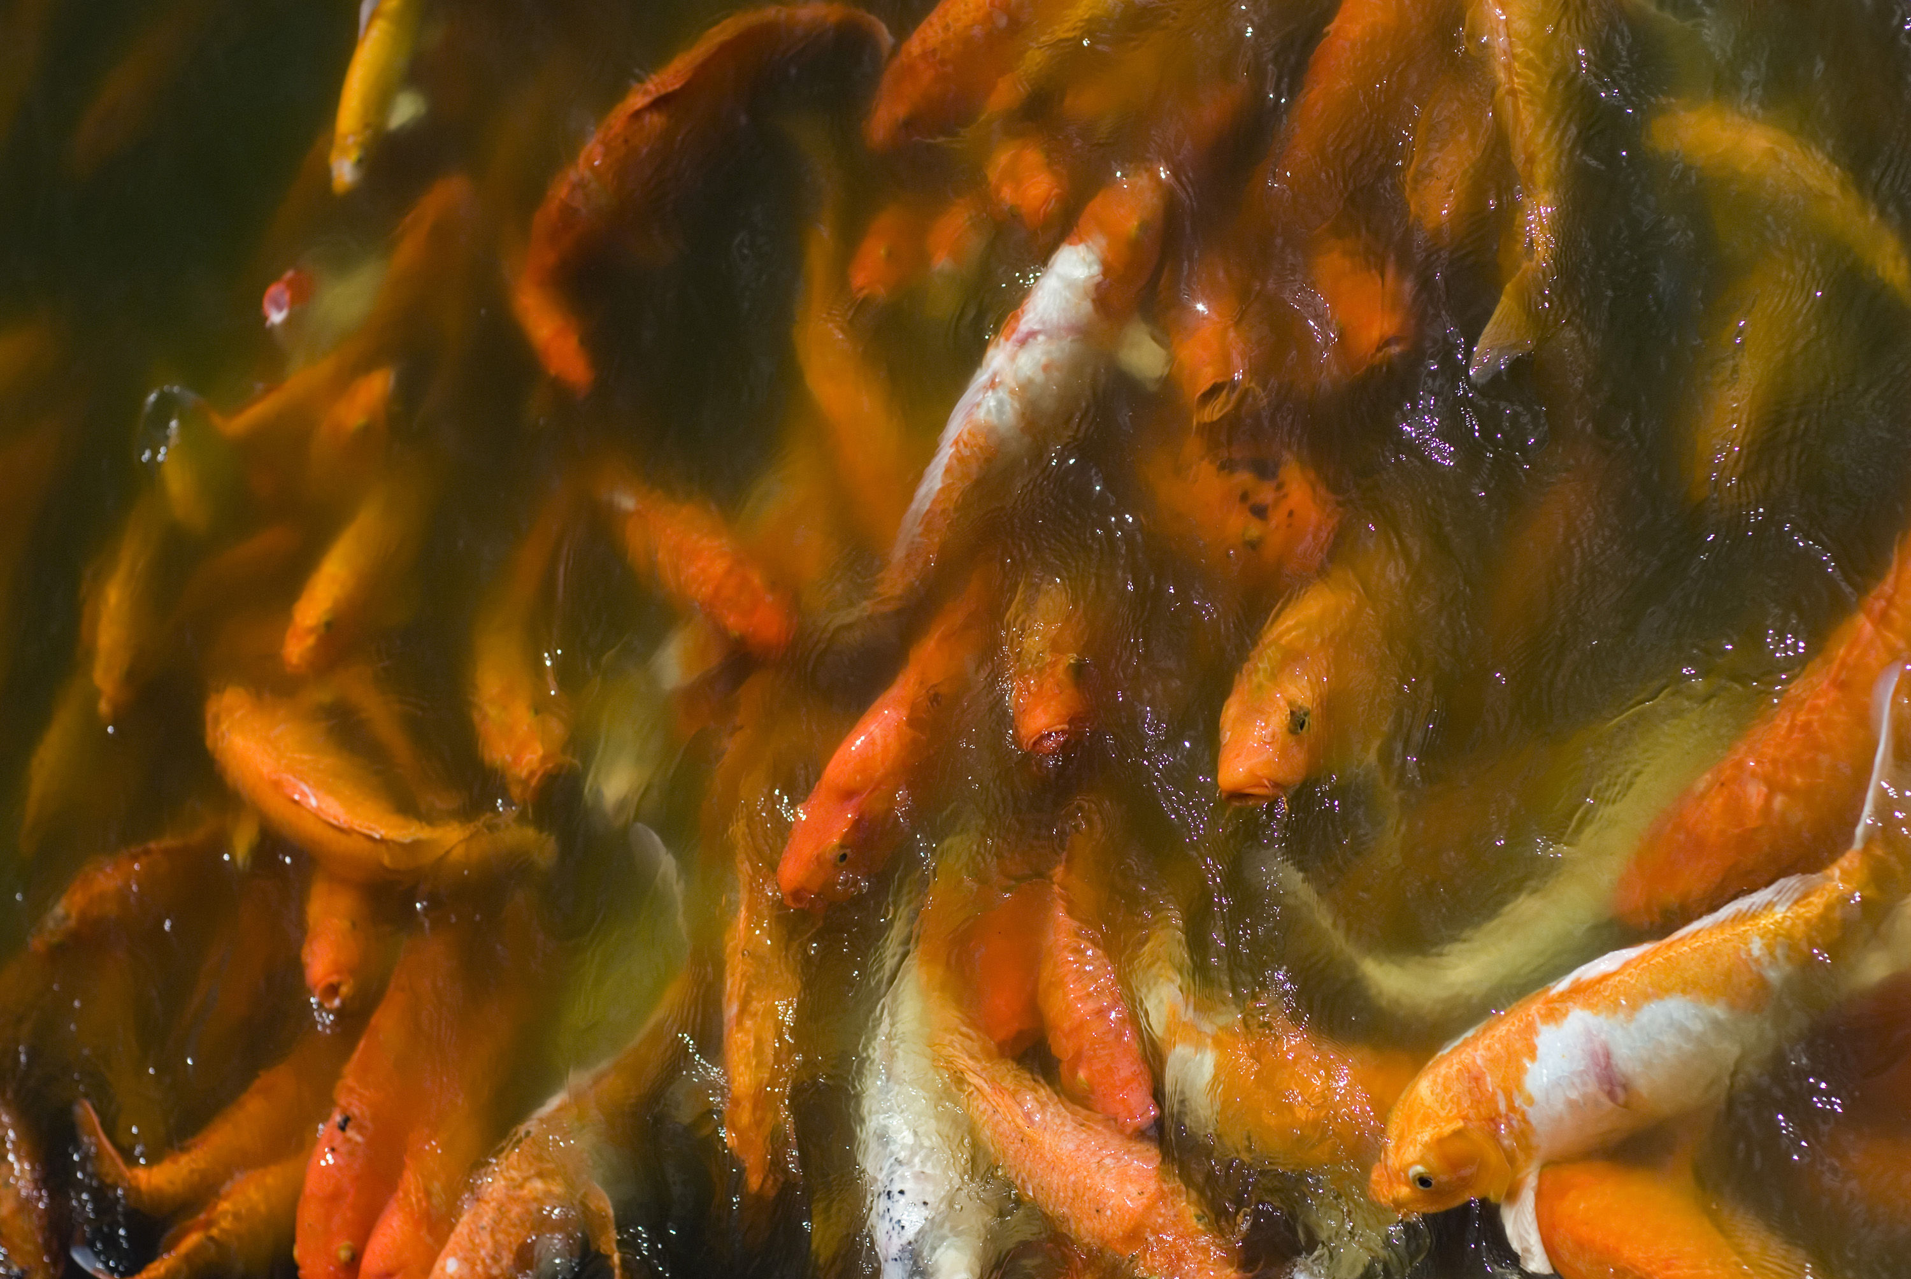
5. Fish-farming and breeding
The consumption of fish in Assam is very high. But the fish-farming and breeding techniques haven’t improved much to meet the growing demand of fish in the region. To increase the productivity and reduce input cost, IoT application to monitor dissolved oxygen, pH indicator, Ammonium nitrate indicator as well as automatic fish feed system can help reduce manpower and improve quality & quantity.
This Photo by Unknown Author is licensed under CC BY

Slide 19
BLOCK DIAGRAM FOR SMART AGRICULTURE

Slide 20
Block Diagram For Vertical Agricultural

Slide 21
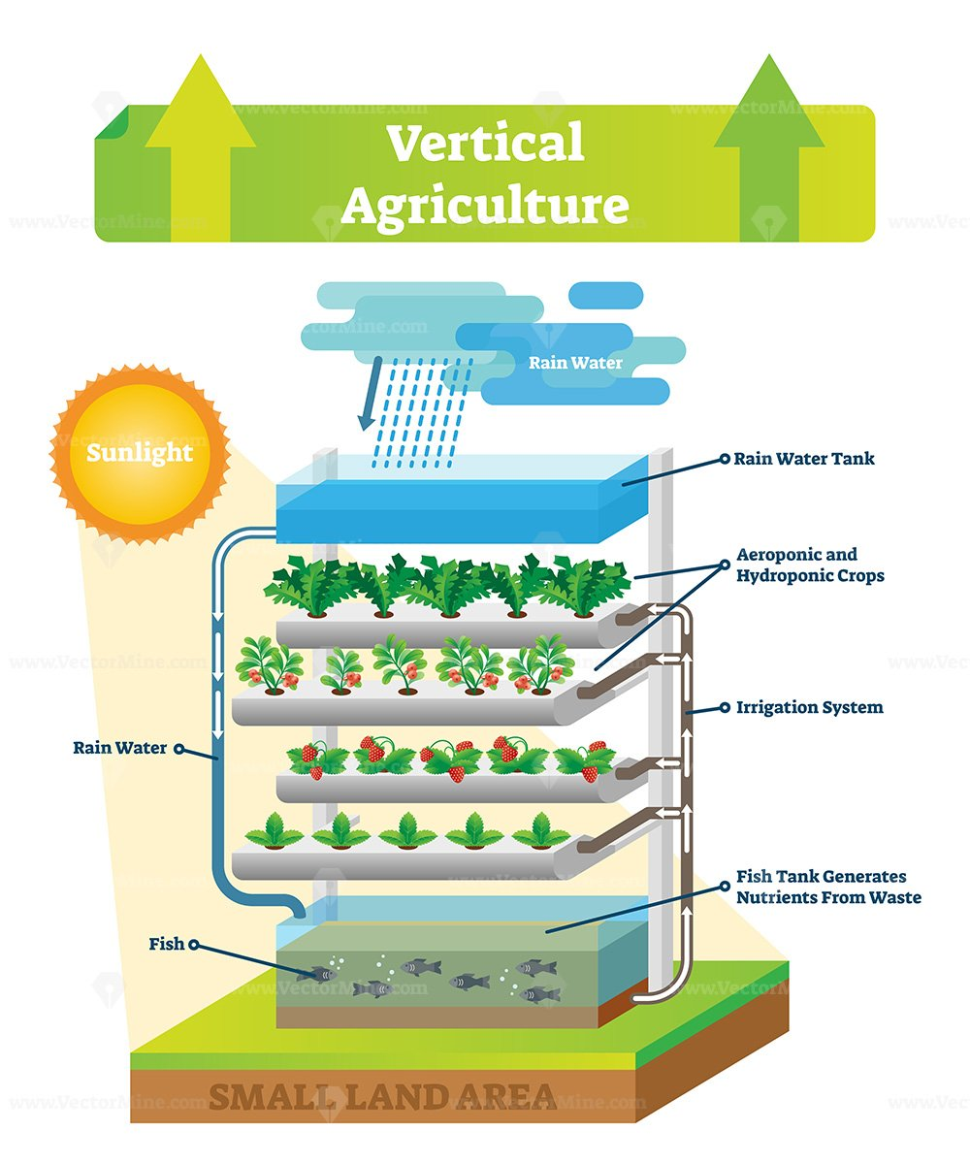

Slide 22
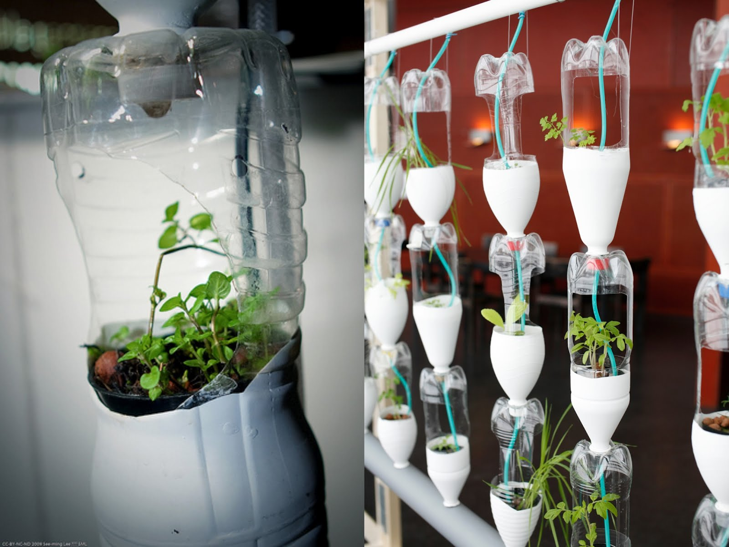
Material and Components of Vertical Farm
Commercial urban agriculture can be made more sustainable because it can reduce irrigation water waste by 40–60% and increase yields by 3–4 times when hydroponically nutrient-rich water is stored and reused in automatic and climate-controlled buildings . Although the use of this technology in indoor VF will be more costly due to the use of artificial materials, the cost will be higher due to the use of local material However, in , the authors indicated it is also possible to make commercial UF sustainable and profitable by using smart technologies
This Photo by Unknown Author is licensed under CC BY-NC-ND

Slide 23
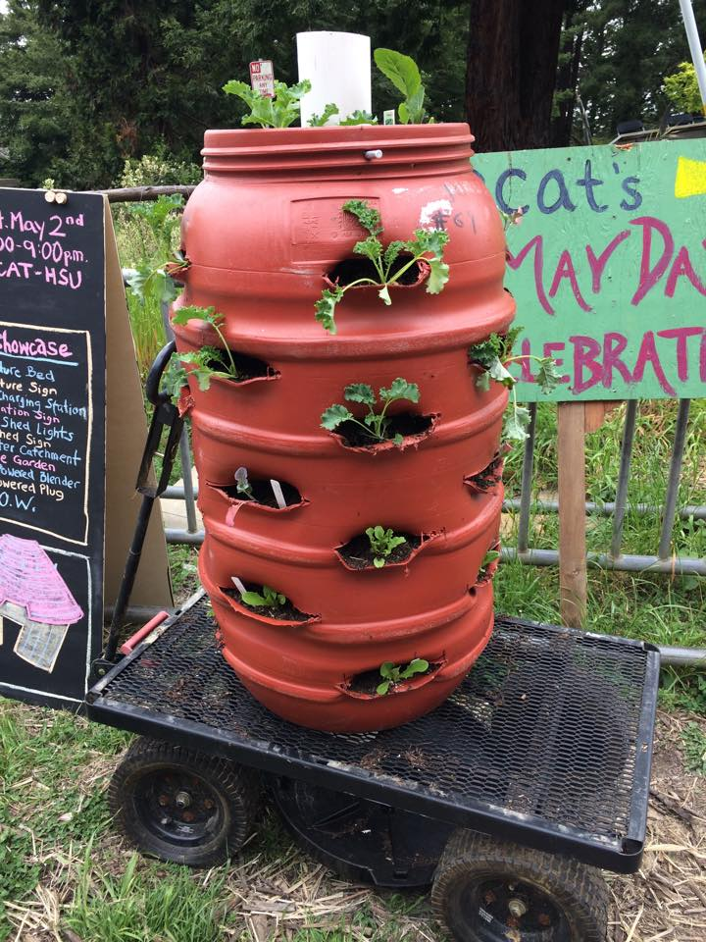
Technologies in Smart Vertical Farming
VF is a state-of-the-art technology that has given an open scope to modern farming in a rural environment and range . The aim of this study, sincerity towards USVF and the use of technology, have invented this new type of agricultural thinking. The Electronics of 40 agriculture industry could be further developed by employing new technologies in the era of modernization.
This Photo by Unknown Author is licensed under CC BY-SA

Slide 24
Conclusion
Carbon-smart farming yields comprehensive soil intelligence, which can help farmers and farm advisors “read their soil”, make the right decisions for maximising profits, and reduce waste. This information can help us better understand what the soil needs to feed our planet while continuing to sequester carbon

Slide 25
THANK YOU

